Slide 1
Predictive Analysis of
Diabetes in Pima Indians
Paul Kadota, Gabe Meltzer, and Jeff Oliver-Smith

Slide 2
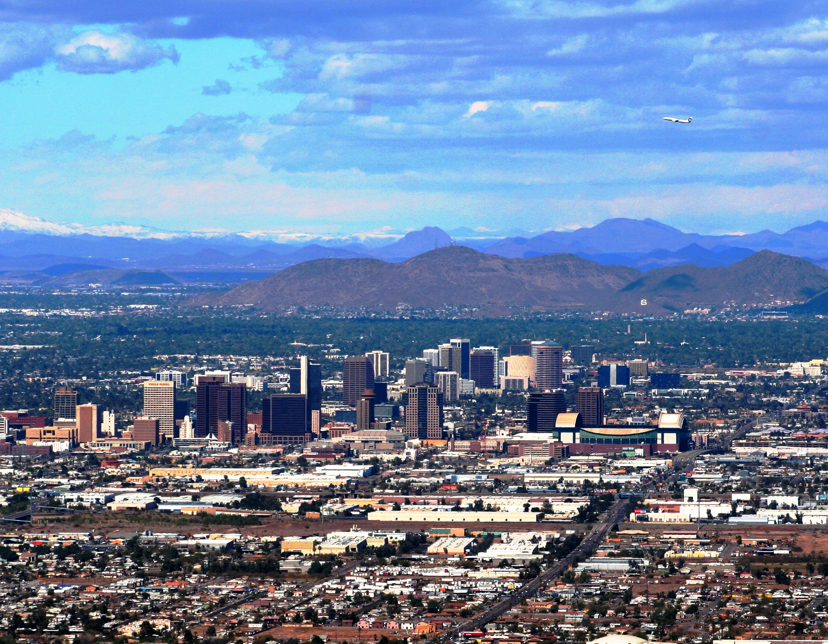
Study Background
Population for dataset was the Pima Indian population located near Phoenix, Arizona
Dataset was used in a study relating to diabetes among the Pima Indian population
Published in 1988 article
Population was being continuously monitored since 1965 due to abnormally high incidence of diabetes
Only women are included in the study

Slide 3
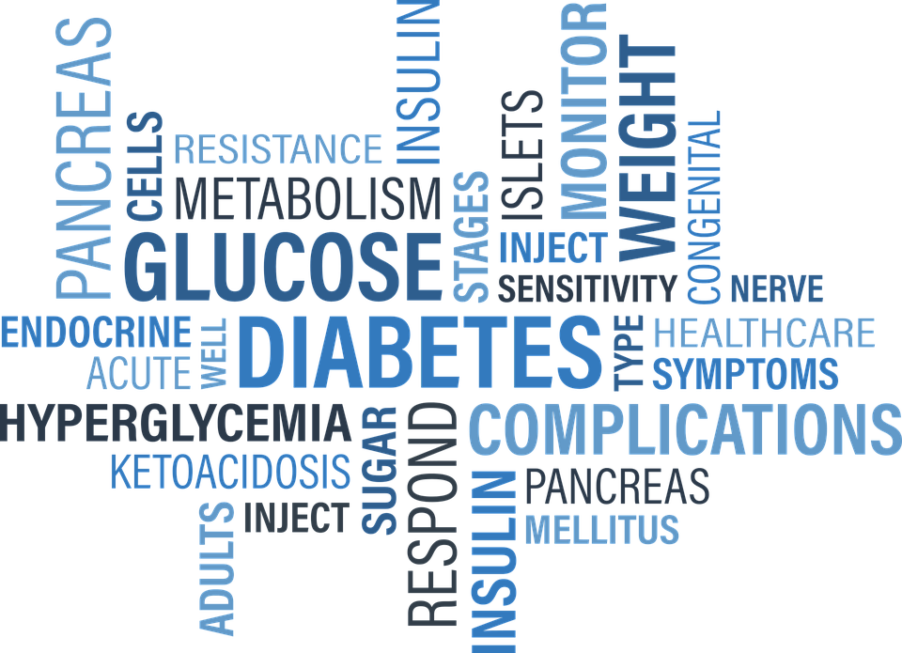
Diabetes Background
422 Million people worldwide, over 29 Million in US alone
One of the most common health problems
Two types of diabetes:
Type 1 is genetic- juvenile onset diabetes ~5% of diabetes
Lack of insulin production
Type 2 is generally developed in adulthood- adult onset diabetes ~95% of diabetes
Characterized by insulin resistance
Diabetes studied is Type 2 diabetes, also known as non insulin-dependent diabetes

Slide 4
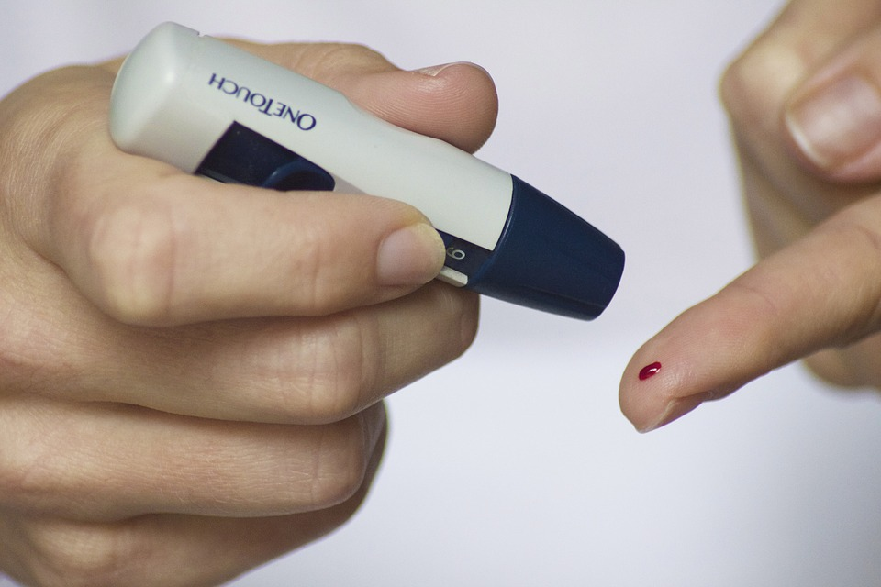
Type II Diabetes Background
Body does not respond appropriately to insulin
Glucose is not absorbed properly because of this, which results in high blood sugar levels
Blood vessel damage, kidney damage and muscle issues can result
Lifestyle factors and genetics contribute to Type 2 diabetes, so a prediction algorithm is feasible
Diagnosed based on symptoms of hyperglycemia (blood glucose too high) and abnormal blood test results
Patients must monitor blood glucose levels and inject insulin as needed
May have an insulin pump

Slide 5
Study Background
Eight variables were measured in an attempt to predict occurrence of diabetes using a learning algorithm
Each variable is a diagnostic measure
Learning algorithm used in the study involves the use of neural networks
Performance measured using sensitivity, specificity, and an ROC curve
768 individuals were selected
576 consisted of the training set - 192 consisted of the testing set
The hypothesis was whether or not the algorithm could forecast in the 192 testing set whether the individuals would develop diabetes in five years using the eight variables

Slide 6
Study Background
Insulin: 2-Hour Serum Insulin
Glucose: Plasma Glucose Concentrations at 2 hours in an Oral Tolerance Test
Skin Thickness: Triceps Skin Fold Thickness (mm)
Pregnancies: Number of Times Pregnant.
BMI: Body Mass Index
Blood Pressure: Diastolic Blood Pressure.

Slide 7
Study Background
The eight variables are:
Pregnancies: Number of Times Pregnant (this could be rather high)
Glucose: Plasma Glucose Concentrations at 2 hours in an Oral Tolerance Test
Blood Pressure: Diastolic Blood Pressure
Skin Thickness: Triceps Skin Fold Thickness (measured in mm)
Insulin: 2-Hour Serum Insulin
BMI: Body Mass Index
Age: Age in years
Diabetes Pedigree Function: Relates to the heritability of diabetes and its occurrence in family members.
Parents or full siblings are given more weight than grandparents, uncles, aunts or half-siblings, who are given more weight than half aunts, half uncles or first cousins

Slide 8
Analysis Overview
Text about what the graphs say.
Basic Analysis
Regression
Clustering
Visualizing Data
Removing Data
Summary Statistics
Correlation
TTESTs
Logistic Regression
Predictor Variables
K-Fold X Validation
ROC
AUC
Hierarchical BMI
Hierarchical Glucose
Hierarchical Combine
K-Means
MDS

Slide 9
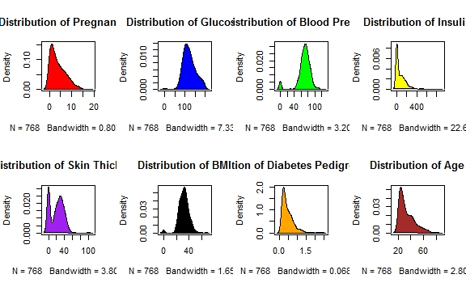
Visualizing the Data (Removing Placeholder Values)
By plotting the density of each parameter, we can see a bimodal distribution caused by “0” placeholders
These zeros are clearly placeholders for parameters that were not recorded.
These zeros need to be removed

Slide 10
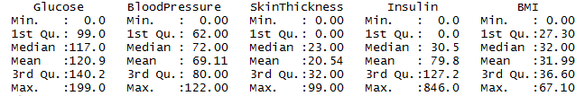
Removing Placeholder Values
A number of values are zero values (missing data points)
Nonsensical values are found in the following variables: Glucose, Insulin, SkinThickness, BloodPressure and BMI.
Leaving these values in can severely impact the analysis of our dataset.
For instance, a lot of zero values will artificially lower the averages
We concluded it was best to filter out these values, since they would severely interfere with our calculations.
392 individuals are recorded using all the appropriate values.

Slide 11
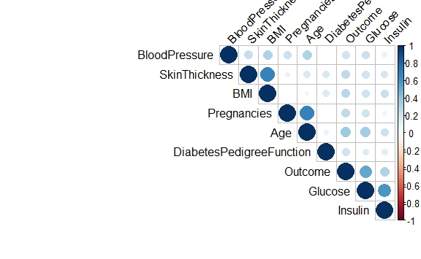
Correlation
Correlation is a statistical technique that can show how strongly pairs of variables are related (see correlation matrix)
Using 0.5 as a cut-off, the following variables show significant correlation:
Age : Pregnancy (.68)
BMI : Skin Thickness (.66)
Glucose: Outcome (.52)

Slide 12
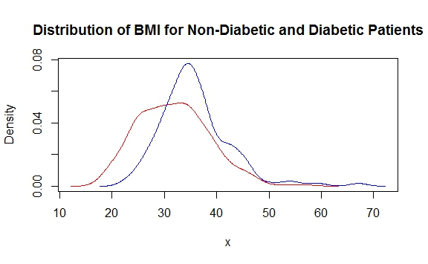
Visualizing the Data (T-Test)
This density plot of the distributions of Non-Diabetic (red) and Diabetic (blue) patient's BMI:
Confirms normality
Shows difference in peaks synonymous with difference in means

Slide 13
T-test (1)
Dataset divided into two frames based on the outcome of diabetes (yes or no)
The case includes the samples with diabetes.
The control includes the samples without diabetes
T-tests are then performed comparing the average of both the case and control, to see if there is a difference in means for various variables.
Variables tested include:
Pregnancies, Glucose, Blood Pressure, SkinThickness, Insulin, BMI, DiabetesPedigreeFunction and Age

Slide 14
T-Test (2)
We have eight null hypotheses, one for each of the variables.
The null hypothesis for each variable is that there is no difference in means for each variable between the control group and the case group.
We have eight alternative hypotheses, one for each of the variables.
The alternative hypothesis for each variable is that there is a difference in means for each variable between the control group and the case group.
The p-values that running a t-test on each variable gives us are as follows:
Pregnancies = 7.618e-06; Glucose < 2.2e-16 ; BloodPressure = 0.0002131; SkinThickness = 1.677e-07; Insulin = 3.429e-08; BMI = 6.797e-08; DiabetesPedigreeFunction = 0.0001749; Age = 3.098e-11
All p-values are significant

Slide 15
T-Test (3)
Based on this, we can reject all 8 null hypotheses, and accept all 8 alternative hypotheses.
There is a difference in means between case and control for all 8 variables.
This suggests that the designers of the study chose good variables to use for studying, and predicting diabetes.
For the DiabetesPedigreeFunction, the confidence intervals for the value of the difference in means are all less than one, however, since the range of values for this variable are so small, this is expected.
Values range between 0.085 and 2.420

Slide 16
Logistic Regression
A logistic regression was performed using Outcome as a response variable, and all the other 8 variables as the various predictor variables.
The null hypothesis for our logistic regression is that there is no relationship between the response variable Outcome and the predictor variables.
The alternative hypothesis for the logistic regression is that there is a relationship between the response variable Outcome and the predictor variables.
The analysis shows that we can reject the null hypothesis and accept the alternative hypothesis, as discussed in the next slide.

Slide 17
Logistic Regression
Glucose is shown to be a significant predictor variable; p-value = 3.24e-11, which is less than 0.001
Other significant predictor variables are BMI and the DiabetesPedigreeFunction, with p-values of 0.00989 and 0.00760
Both p-values are less than 0.01, so this is within the scientific standard of 0.05
Beta values for Glucose, BMI, and DiabetesPedigreeFunction are as follows
3.287e-02
7.054e-02
1.141

Slide 18
Logistic Regression
This means that for each unit increase in Glucose, the odds of a patient having diabetes increases by 3.9011%.
e^(3.287e-02) = 1.039011
For each unit increase in BMI, the odds of a patient having diabetes increases by 7.3085%.
e^(7.054e-02) = 1.073085
For each unit increase in DiabetesPedigreeFunction, the odds of a patient having diabetes increases by 212.9611%.
e^(1.141) = 3.129611
This large increase actually makes sense since the spread of DiabetesPedigreeFunction is very small. An increase of 1 unit would actually be pretty large and probably unusual.

Slide 19
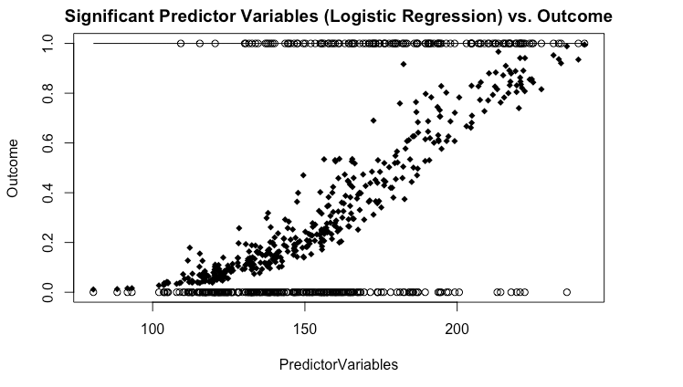
Logistic Regression (Glucose, BMI, DPF)

Slide 20
K-fold Cross Validation Analysis
4-fold cross validation on filtered data
Split data into 4 equal divisions
Use each one as a test set against the others
Use cross validations to create ROCR objects
Obtain area under curve to determine strength
For Logistic regression model using all predictors: average AUC = 0.8479
For Logistic regression model using significant predictors: average AUC = 0.8478
For Linear regression model using all predictors: average AUC = 0.8421

Slide 21
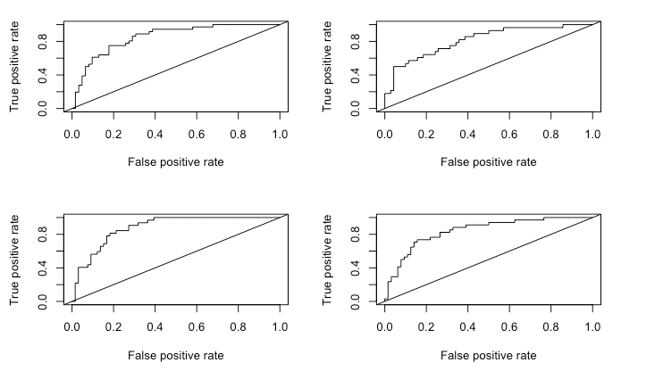
Logistic Regression ROCR (all variables)

Slide 22
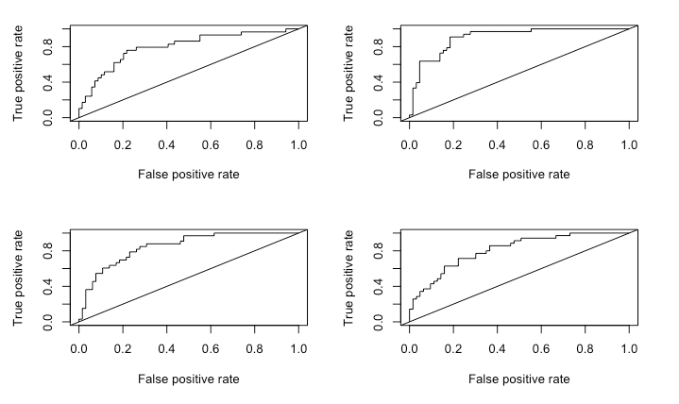
Logistic Regression ROCR (BMI, Glucose, DPF)

Slide 23
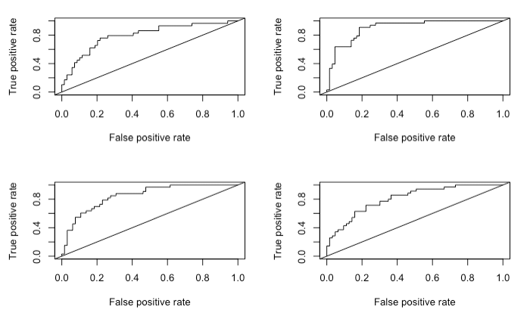
4-fold cross validation: Linear Regression ROCR

Slide 24
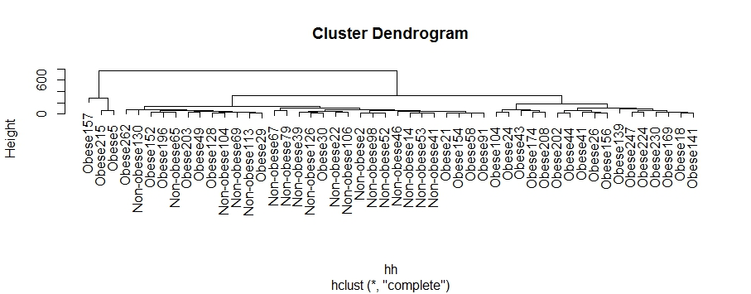
Hierarchical Clustering (Binned BMI)
Created a new variable, BMI category, which used a cut-off of BMI<30 for Non-Obese & BMI >= 30 for Obese.
Hierarchical clustering of a sample shows clusters of Obese & Non-Obese

Slide 25
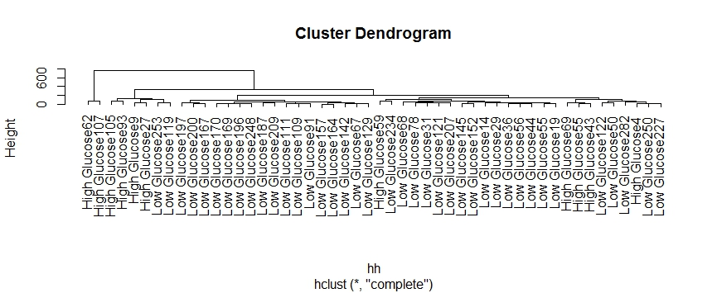
Hierarchical Clustering (Binned Glucose)
Created a new variable, Glucose category, which used a cut-off of Glucose Conc<140 for Low Glucose & Glucose Conc>=140 for High Glucose.
Hierarchical clustering of a sample shows clusters of Low & High Glucose

Slide 26
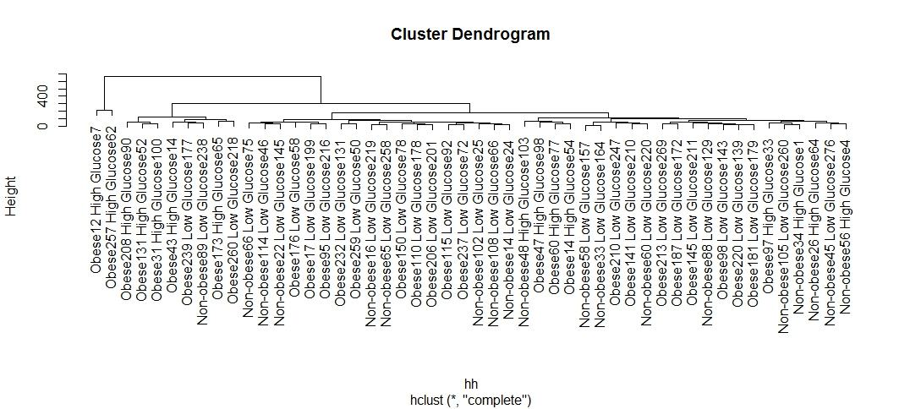
Hierarchical Clustering (Binned Glucose & BMI)

Slide 27
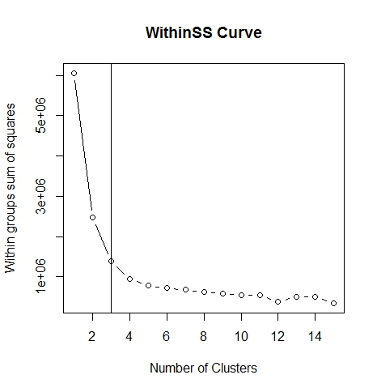
K-means Clustering
This plot shows the within sum of squares of several values of K.
Ideally, we want to minimize wss without getting an absurd number of clusters
Visually, I chose a cut-off of 3.

Slide 28
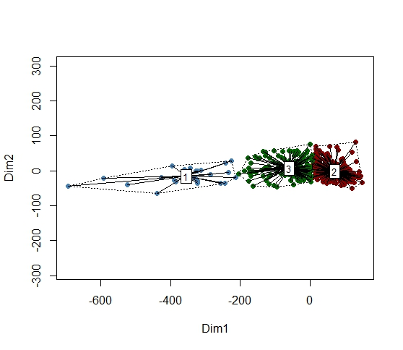
Multidimensional Scaling (MDS)
Multidimensional Scaling (MDS) shows the similarity between multiple rows (patient samples) and columns (test parameters).
This is an MDS plot using groups from K-means (k=3).

Slide 29
Useful Results and Conclusion
Dividing based on outcome, all t-tests between case and control groups were significant
All 8 t-tests yielded significant p-values
Based on logistic regression, several variables were found to be significant predictors:
Glucose levels
Body Mass Index (BMI)
Diabetes Pedigree Function
Clustering shows how binned variables of BMI and Glucose show a trend across all variables
It is possible to use these metrics as accurate predictors for developing diabetes in this population

Slide 30
Reference Sources
https://www.kaggle.com/uciml/pima-indians-diabetes-database (source of diabetes dataset)
http://www.biostathandbook.com/multiplelogistic.html (logistic regression slides)
http://www.who.int/diabetes/action_online/basics/en/index3.html (WHO diabetes background)
https://web.archive.org/web/20130826174444/http://www.who.int/mediacentre/factsheets/fs312/en/ (background of study slides)
https://www.cdc.gov/chronicdisease/resources/publications/aag/pdf/2016/diabetes-aag.pdf (CDC info on diabetes)
Smith, J.W., Everhart, J.E., Dickson, W.C., Knowler, W.C., & Johannes, R.S. (1988). Using the ADAP learning algorithm to forecast the onset of diabetes mellitus. In Proceedings of the Symposium on Computer Applications and Medical Care (pp. 261--265). IEEE Computer Society Press.

